Slide 1
Practice Lab:
This Practice Lab is dependent on Discussion Unit 6210, where most of the objects we create in this lab were introduced.
In this Practice Lab, we install DSE Studio from Tar ball, configure it, and run a basic install verification; create a table, add data, query same.
DSE Studio, Install, Configure, First Steps
Notes:
The goal of this Practice Lab is to get DSE Studio installed, configured, and perform a single query (to act as our install verification).

Slide 2
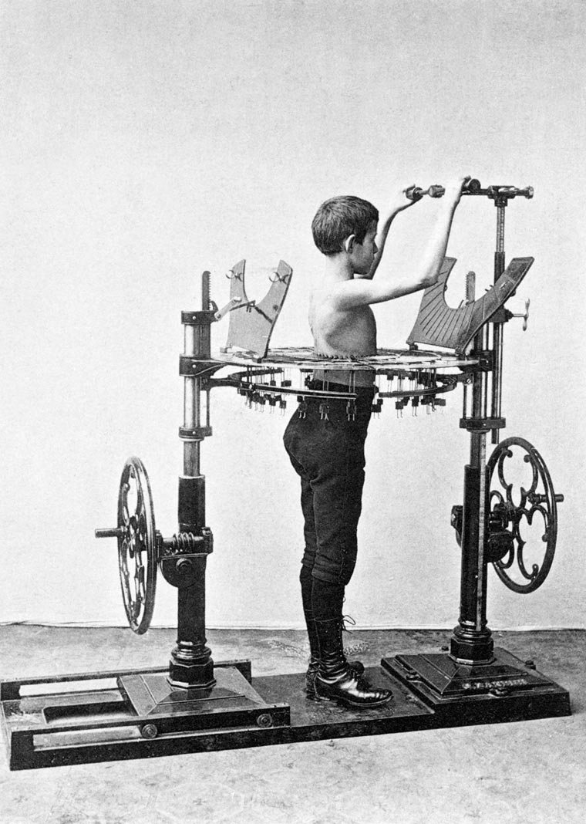
Challenge 1: Install, Configure, run DSE Studio
Prerequisites:
Instructions are provided for Linux
We will operate below recommended settings; 1 OS node only, minimum 8 GB RAM, 12 GB RAM preferred
That you have an operating single node DSE Core cluster (anything more likely wont fit; DSE Core plus Studio on 8 GB RAM)
All work done as ‘root’
Notes:
To complete this Practice Lab, the following is assumed:
All prerequisites and conditions as listed above.
All work is expected to be executed on one OS node (instructions are written for Linux).
Because of resource constraints, it is expected you are running a single DSE Core node (no Graph, Spark, Search) on this single OS node.

Slide 3
Challenge 1: Files, Directories
Download Studio from Academy,
https://academy.datastax.com/downloads
Unpack the DSE Studio Tar ball in /opt/studio
Notes:
Complete all steps as listed above.

Slide 4
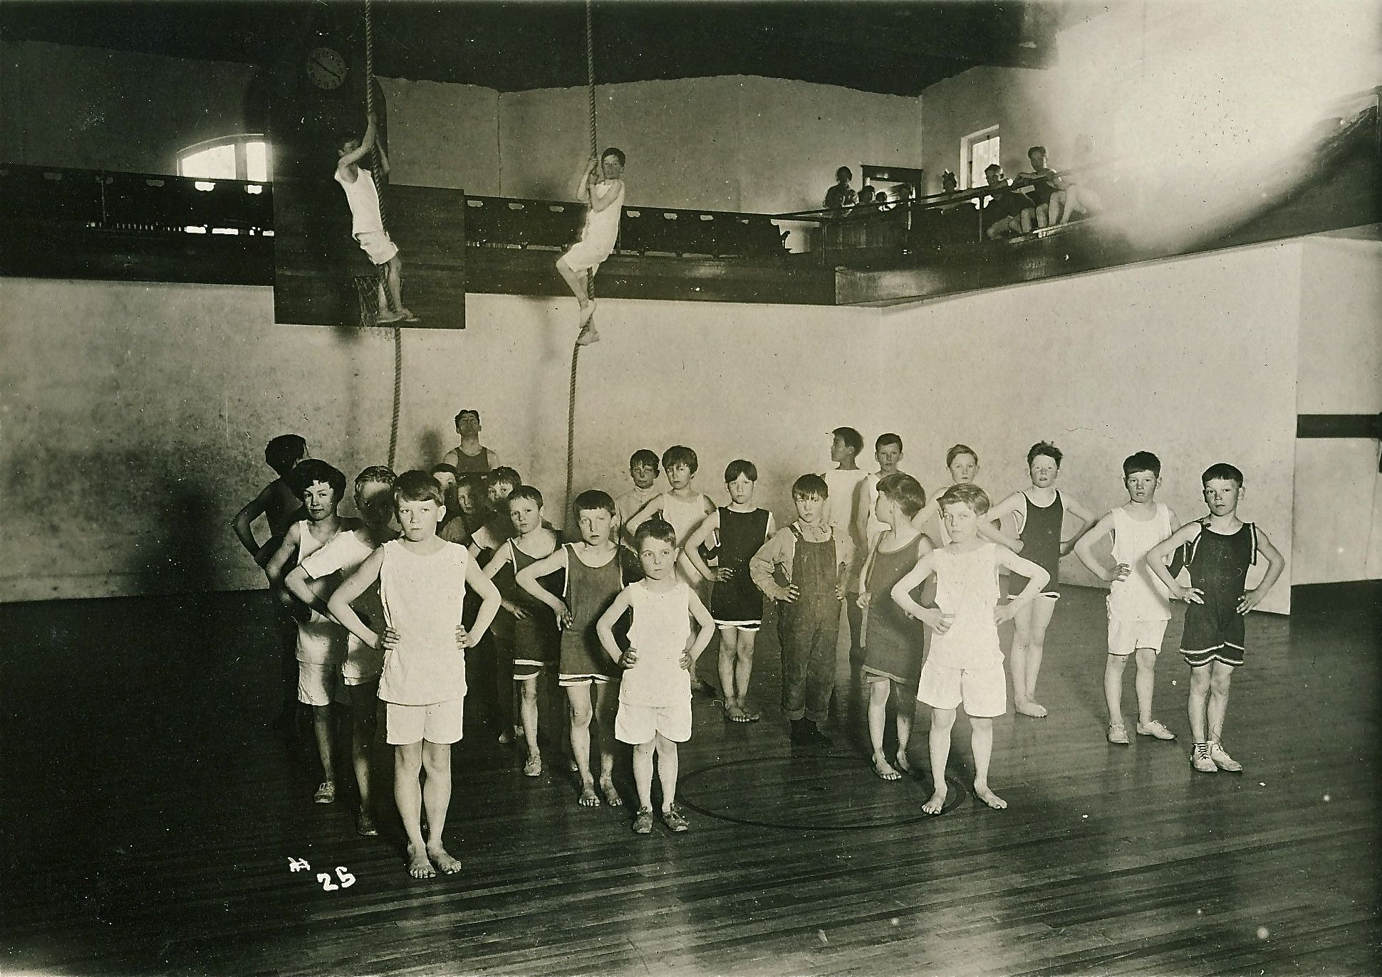
Challenge 1: Configure
cd /opt/studio/conf
ls –l
(Edit configuration.yaml)
-- Optional step, as no changes
are required
-- We changed
userData:
baseDirectory: /opt/studio_data
-- Make sure directory above
exists
Notes:
All of these steps are optional; primarily we want to make you aware of the location of the DSE Studio configuration.yaml file.

Slide 5
Challenge 1: Start Studio (Web client server)
cd /opt/studio/bin
./server.sh
In Web browser,
localhost:9091
Next Page
Notes:
Complete all steps as listed above.
The first time you boot DSE Studio, it can take nearly one minute to become operational. By default, Studio is accessible via, localhost:9091

Slide 6
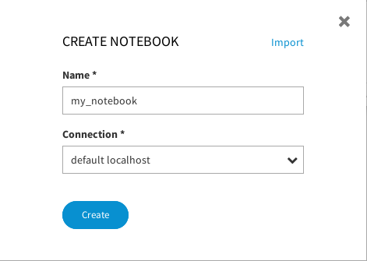
Challenge 1: Install verify
In Studio Web UI:
Click the large PLUS symbol
This action produces a modal dialog box titled, CREATE NOTEBOOK
Enter data as shown at right
Click -> Create
Notes:
Complete all steps as listed above.
Click the large PLUS symbol to call to create a new Studio Notebook.
This action produces a modal dialog box as shown.
Name the Notebook, and select the connection (to DSE) titled, "default localhost".
Click -> Create

Slide 7
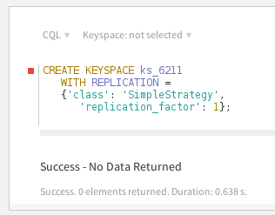

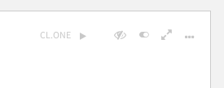
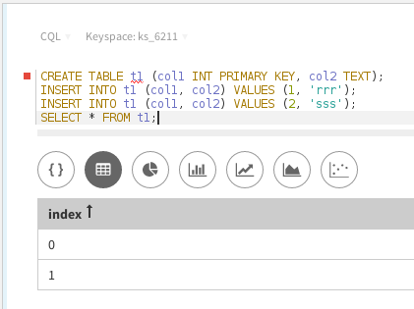
Challenge 1: Make Keyspace, table, data, select
Enter CQL to CREATE KEYSPACE
Click the (Run button) (CL.ONE is a reference to consistency level one)
Add a new Cell; Click the small grey plus symbol on the bottom-line/middle of any existing cell
In the new Cell, chose a target keyspace
Add and run CQL to CREATE TABLE, ..
Run
Notes:
Complete all steps as listed above.
Studio can create and drop keyspaces. First, create a new keyspace titled, ks_6211.
Enter the CREATE KEYSPACE syntax as shown, then click the CL.ONE button on the tool bar, located on the upper right.
Create a new Studio Notebook cell by clicking the small plus sign on the bottom of the only/existing cell; the cell where we just created a new keyspace.
Select the target keyspace for this cell via the drop down list box initially titled, "Keyspace: not selected". Select the keyspace titled, ks_6211.
Enter the CQL commands to CREATE TABLE, etcetera, and run.

Slide 8
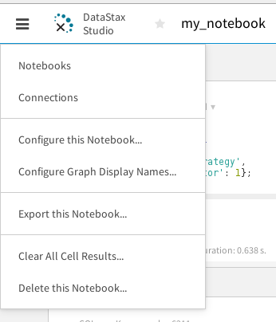
Challenge 2: Export/drop Notebook
1
In Studio Web UI:
Click the left most icon in the Toolbar (balloon help titles this icon, Main Menu).
Select -> Export
Follow prompts to save (file, a Tar ball) to the Desktop.
Then, follow prompts to "Delete this Notebook"
2
3
Notes:
DSE Studio can export and import the Notebooks you create, with many options; include results data, or not, other.
Our goal with Challenge 2 is to:
Export a Notebook
Drop same
Import the Notebook
These steps are meant to imitate sharing Notebooks between co-workers, other.

Slide 9
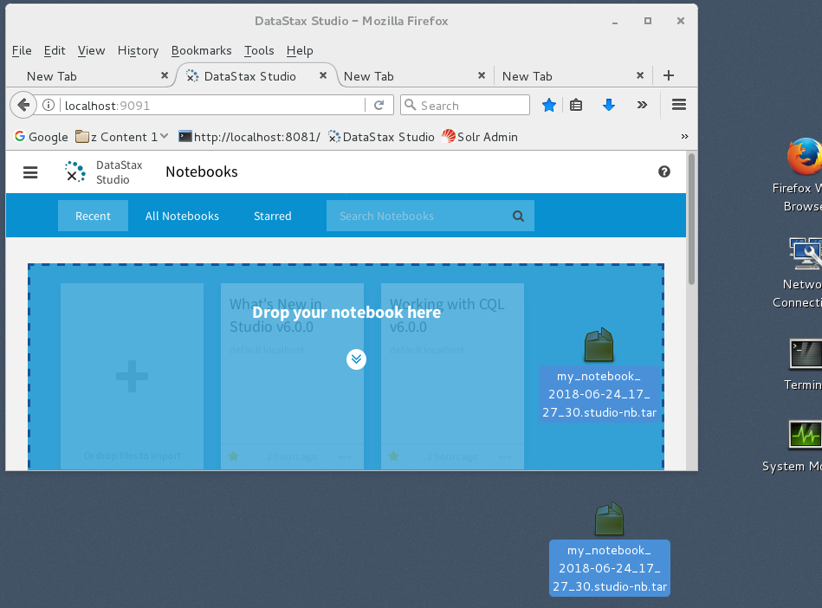
Challenge 2: Import a Notebook
In Studio Web UI:
Drag and Drop the previously exported Notebook from the Desktop to the Studio (canvas)
You will need to reselect Keyspaces on imported Notebooks
Notes:
To import a previously exported Notebook, Drag and Drop the Notebook to the Studio (canvas).

Slide 10

Go Father: (Optional)
Vasco Núñez de Balboa was a Spanish explorer (or conquistador) who saw and claimed the Pacific Ocean for Spain. He was born in 1475 in a poor region of Spain known as Extremadura, which was also the home of conquistadors Hernán Cortés, Francisco Pizarro, Hernando de Soto, and Francisco de Orellana.
Source: http://mrnussbaum.com/explorers/famous-explorers/
Notes:
Go farther in this Practice Lab: given sample syntax, build something new.
This lab may not fit on your box:
If you are running on a single Linux OS with 8 GM RAM, this Practice Lab may fail due to (insufficient resource, RAM). If so, your instructor may ask that you move on. This Practice Lab could generally operate on very small sized data when given 12 GB RAM, which is still below recommended values, fyi.

Slide 11
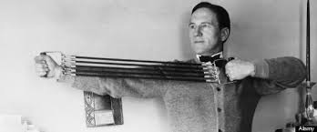
Challenge 3 (Optional): Run Spark/SQL
From the command line:
Shutdown down your single node DSE Core
Edit the dse.yaml. Change
alwayson_sql_options:
enabled: true
(With proper indentation)
Restart DSE. Add a –k option on the command line
Restart the DSE Studio daemon (see Notes)
Notes:
Complete all steps as listed above.
In Challenge 3, we attempt to run Spark/SQL using DSE Studio
Spark/SQL is forked from Hive/SQL version 1.x, which is largely similar to ANSI SQL/99. If all works well, you should be able to run a standard SQL join of two small tables.
Shutdown your single node DSE Core
Edit the dse.yaml; make the changes listed above.
Restart DSE with a –k (DSE Analytics, Spark) option present. Do not add Search or Graph at this time; you likely wont have enough RAM.
Note: DSE may start, and the DSE Analytics sub-system may fail to initialize. If so, there will be errors in the DSE boot log; a topic we do not expand upon at this time. (We already know that we are grossly trying to run below recommended amounts of RAM, other.)
While not required; it's just easier to restart the DSE Studio Web UI daemon.

Slide 12
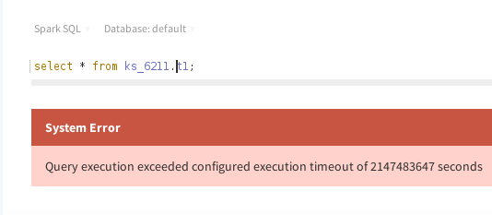
Challenge 3 (Optional): Spurious error
Notes:
Complete all steps as listed above.
Using a Web browser, re-enter DSE Studio.
Add a new cell, and use the Drop Down List Box to select, Spark SQL
To start, enter an inane query like, SELECT * FROM ( table )
Because we are failing to meet the required minimum runtime configuration (RAM), you may get the spurious error displayed above. Simply call to rerun your query, and it should likely complete.

Slide 13
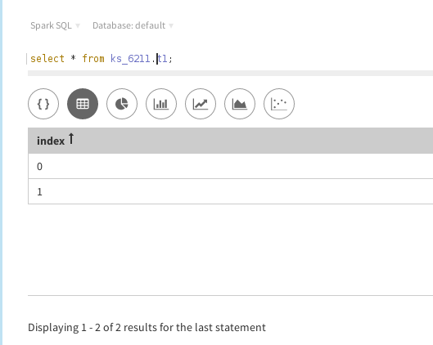
Challenge 3 (Optional): Success
Notes:
Complete all steps as listed above.
Display of a successful query execution above.

Slide 14
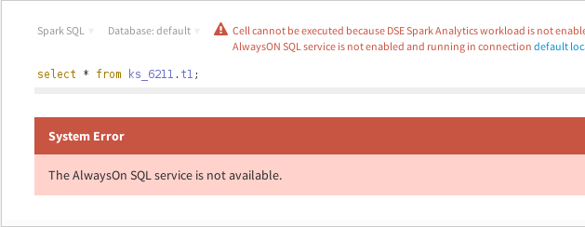
Challenge 3 (Optional): Definite Error (Resource)
Notes:
Complete all steps as listed above.
If you get the error above, give up.
We really should be running this Practice Lab with much more memory. Sometimes (rarely) this lab can run on 8 GB RAM. Often it runs on 12 GB RAM. But the point is; we need a bigger box (more RAM).
With the error above; the Always on SQL component to DSE Analytics failed to initialize. There are specific error messages present in the boot log that we wont pursue; we already know we're doing something wrong (trying to run too much with too little RAM).

Slide 15

Practice Lab:
Lessons Learned
Notes:
Discuss what worked well, poorly, from the Practice Lab.

Slide 16
Notes:
End of Practice Lab-

